Slide 1
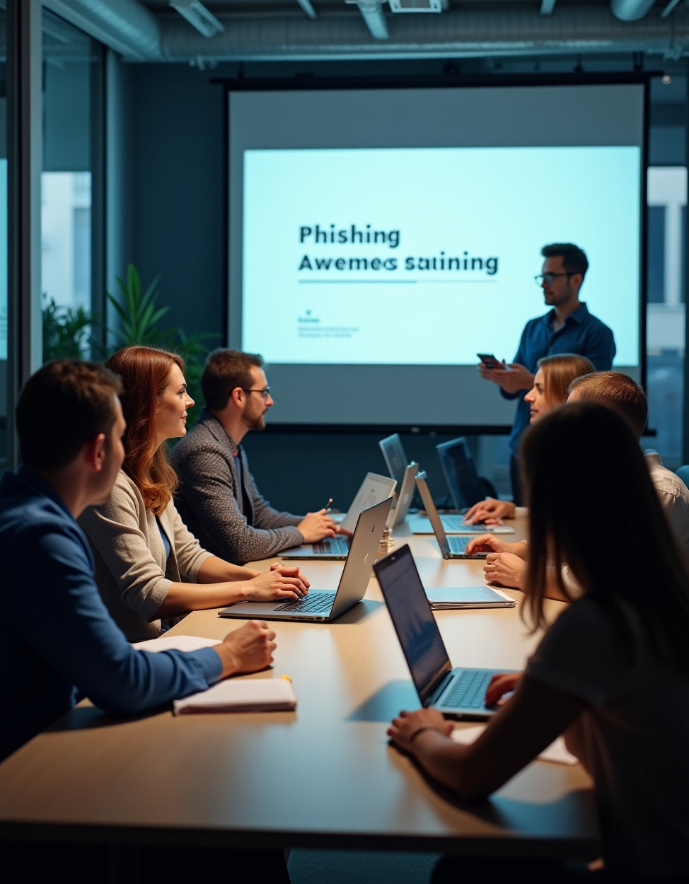
Phishing Awareness Training

Slide 2

Introduction
This presentation focuses on understanding phishing attacks, recognizing their signs, and implementing strategies to protect against them. By the end, you will learn about different types of phishing, how to identify suspicious communications, and best practices to mitigate risks.

Slide 3

01
Phishing Overview

Slide 4
Definition of phishing
- A cyber attack where attackers trick users into giving away sensitive information.
- Usually done through fake emails, websites, or messages pretending to be legitimate.
🧠 “Phishing = Fake Bait to Catch Real Data”

Slide 5

Types of phishing attacks
- Email Phishing – Fake login links or attachments
- Spear Phishing – Personalized attacks
- Smishing – Phishing via SMS
- Vishing – Voice-based phishing
- Clone Phishing – Duplicated emails with malicious links

Slide 6
Common Signs of a Phishing Email
- Suspicious sender address (e.g., admin@paypa1.com)
- Urgent language: “Act Now!” or “Account Locked!”
- Generic greetings: “Dear user”
- Links that don’t match the website
- Unexpected attachments or QR codes

Slide 7
Real-World Example
Subject: Your bank account is compromised
From: support@hdfcbannk.com
✅ Logo copied from real website
❌ Link goes to http://bit.ly/hdfc-fix (not legitimate)
📷 Screenshot of real phishing email (example)

Slide 8
Impact of phishing on organizations
Phishing attacks can lead to serious consequences for organizations, including financial loss, data breaches, and reputational damage. Understanding these impacts is crucial for implementing effective security measures.

Slide 9

02
Recognizing Phishing

Slide 10
Identifying phishing emails
To identify phishing emails, look for signs such as generic greetings, spelling and grammatical errors, and suspicious links. Legitimate organizations typically address recipients by name and have professional communication standards. Always verify the sender’s email address and be cautious of any sense of urgency that pressures immediate action.

Slide 11
Spotting fake websites
Fake websites often mimic legitimate ones to deceive users. To spot them, check for unusual URL structures, such as slight misspellings of the company’s name, and ensure the URL begins with 'https://'. Look for trust indicators like security certificates and contact information to verify authenticity.

Slide 12
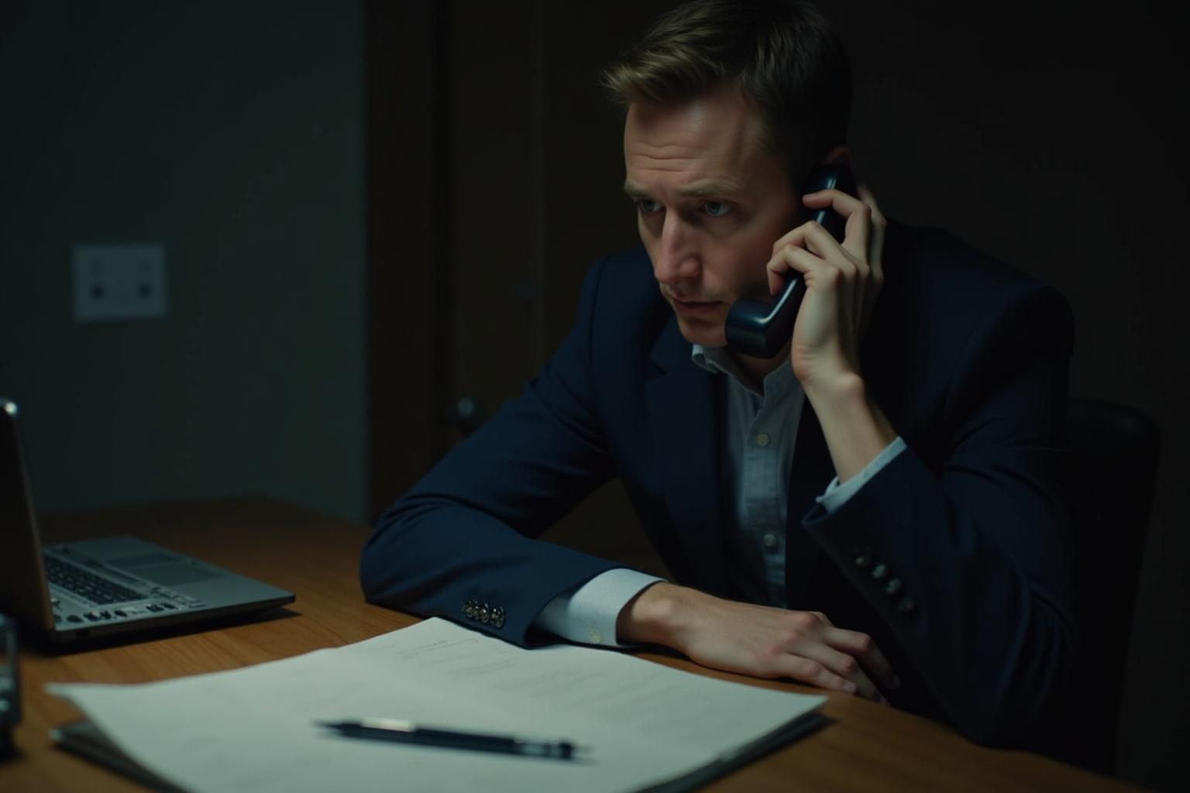
Common social engineering tactics
Attackers often use social engineering tactics to manipulate victims into divulging confidential information. These may include pretexting, where the attacker creates a fabricated scenario, or baiting, which promises a reward in exchange for sensitive data. Awareness of these tactics is crucial in preventing such manipulation.

Slide 13
Social Engineering Tactics
🧠 Attackers exploit:
- Curiosity (“Check this photo”)
- Fear (“Account suspended!”)
- Greed (“You won a prize!”)
- Authority (“From HR Department”)

Slide 14
How Fake Websites Trick You
- Use similar domains: faceb00k.com, g00gle-mail.net
- Replicate login pages with same design
- SSL padlock ≠ legitimacy
🔗 Always hover before you click

Slide 15

03
Prevention Strategies

Slide 16
Best practices for email security
Implementing best practices for email security includes using strong, unique passwords, enabling two-factor authentication, and regularly updating security software. Educate employees about phishing threats and encourage them to report suspicious emails to IT departments.

Slide 17
How to Protect Yourself
- Never click unknown links or attachments.
- Verify sender identity before responding.
- Use Multi-Factor Authentication (MFA)
- Regularly update passwords.
- Report phishing emails to IT/security team.

Slide 18
Tips for safe browsing
For safe browsing, refrain from clicking on unknown links, and be cautious when providing personal information online. Use reputable antivirus software and ensure that websites are secure before entering sensitive data. Regularly monitor your accounts for unauthorized activity.

Slide 19

Importance of employee training
Regular employee training is essential in combating phishing attacks. Training programs should include practical exercises, real-world examples, and strategies to recognize and respond to phishing attempts. An informed workforce is a key line of defense against cyber threats.

Slide 20
Interactive Quiz (Optional)
Q: Which of the following is a sign of phishing?
A. Email from admin@secure.microsoft.com
B. Spelling mistakes and urgency in message
C. A greeting like 'Hello, [Your Full Name]'
✅ Correct Answer: B

Slide 21
Summary
- Phishing is common but preventable.
- Stay alert, double-check everything.
- Spread awareness in workplace, family, and peers.
🧠 “Think Before You Click!”

Slide 22
Conclusions
Phishing awareness is crucial in maintaining organizational security. By understanding the signs of phishing, employing preventative strategies, and regularly training employees, organizations can significantly reduce their risk of falling victim to such cyber threats.

Slide 23
Thank you!

